Slide 1
Global PSP Project for Indian Embassies and Consulates
Quick Guide – Change Applicant Details Screen

Slide 2
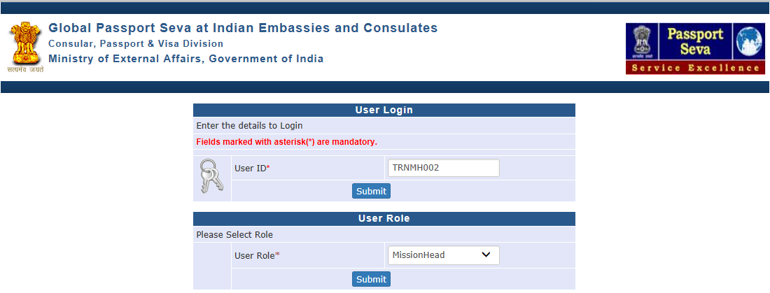
Login Using User ID, Password, and Grid Values
Visit Global PSP Office Portal (https://embassy.passportindia.gov.in)
Enter User ID
Press Submit button
Choose User Role as ‘PIA’ or ‘MissionHead’
Press Submit button displayed below the User Role

Slide 3
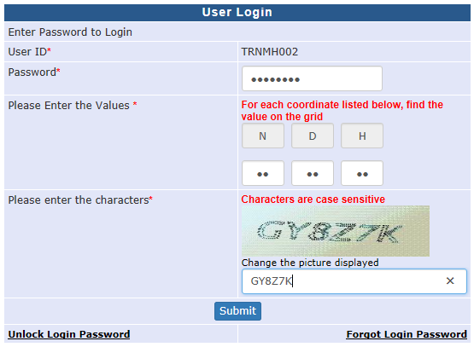
Login Using User ID, Password, and Grid Values (continued..)
Enter Password
Check your User Grid and enter the values for the three alphabets displayed on the screen
Enter the characters displayed in the CAPTCHA image
Press Submit button

Slide 4
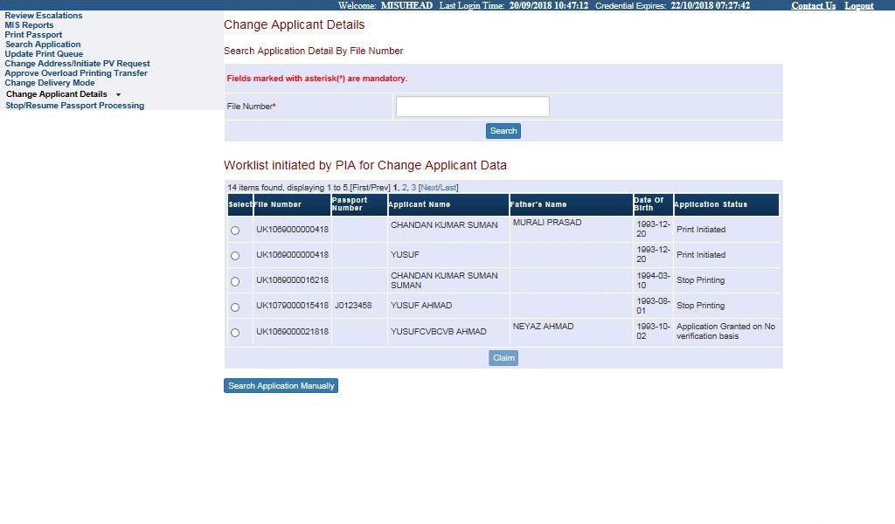
Change Applicant Details
Click on the link ‘Change Applicant Details’
Worklist of cases sent for data modification as part of Reviewing Cancellation of QC Rejection cases, imposition of stop for data modification/other reasons, cases pulled back/sent back from CPPF and so on is displayed in the screen in form of worklist.
Select the file from the work list, or type the file number and search the file from the worklist and press claim button

Slide 5
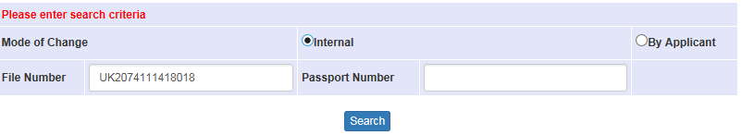
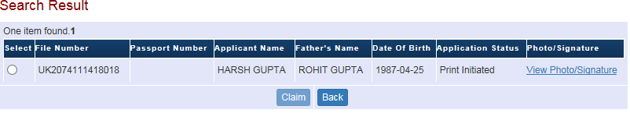
Change Applicant Details - Search Application Manually
Press the ‘Search Application Manually’ button if the desired file number is not visible in the worklist
Select ‘Mode of Change’ from either of the following values
By Applicant: For cases where applicant has requested reprinting of passport with correction in data after the same was issued to him/her
Internal: For data correction needs identified internally for not yet issued passport applications
Enter File Number or Passport Number and Click on Search Button

Slide 6
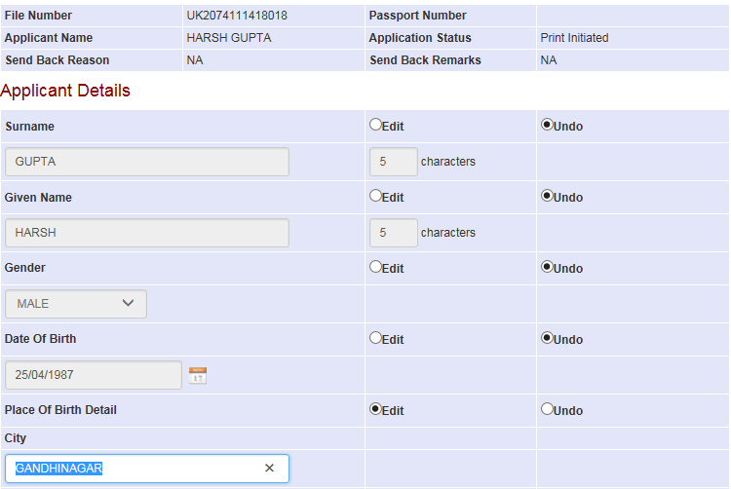
Change Applicant Details (Continue..)
After claiming the file through worklist or through manual search, user is displayed multiple pages of the various passport printable details. User may choose “Edit” option to make changes in a specific field, if required

Slide 7
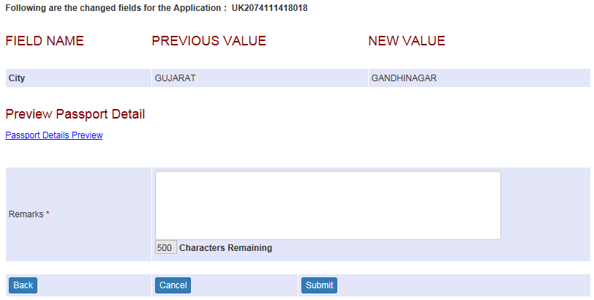
Change Applicant Details (Continue..)
Confirm the previous value and new value for the changed passport printable data fields
Check the updated Passport Preview Details using the hyperlink ‘Passport Details Preview’
Enter proper remarks and press Submit button to implement the changes in the application details stored in the system

Slide 8
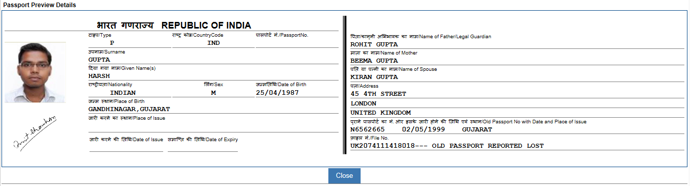
Change Applicant Details (Continue..) – Passport Details Preview
It’s recommended to check the updated Passport Preview Details using the hyperlink ‘Passport Details Preview’

Slide 9
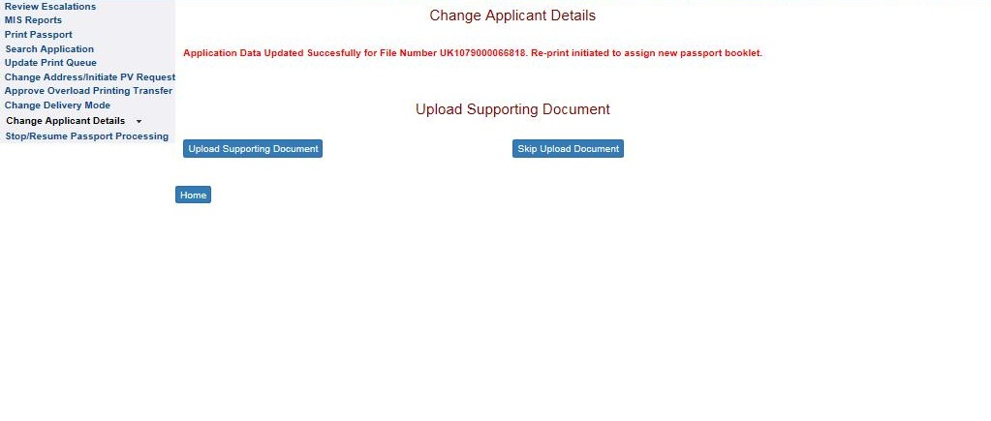
Change Applicant Details (Continue..)
After entering Remarks and pressing the Submit button – user is displayed a provision to upload supporting documents (for the decision regarding change of passport application details). This can be done by clicking the ‘Upload Supporting Document’ button
User can also skip uploading of documents by pressing the ‘Skip Upload Document’ button

Slide 10
In case of additional information or clarification, please contact Global PSP Support Team at
Email : global.psp@tcs.com
Phone : +91-0120-672-9595/96
Mobile : +91-730-351-9595
Thank You

